Slide 1

Flocking of non-holonomic mobile Robots
Amirkhosro Vosughi
EE505 Research Project
Spring 2017

Slide 2

Outline of Presentation
Review main concepts
Trajectory Tracking
Non-holonomic dynamic
Flocking in robotic
Paper Presentation
Obstacle Avoidance
Conclusion
My Contribution
Graph Theory
Problem Formulation
Main Results
Simulation

Slide 3
Keywords
Flocking
Trajectory tracking
Distributed control
Energy function
Obstacle avoidance
Non-holonomic mobile robot
Graph Theory

Slide 4
Flocking in robotic system
Flock motion inspired from nature
Same simple behavior of autonomous individual lead to complex motion pattern
Some artificial agent that can communicate which each other and move as a group
Benefits of Flocking
more efficient when dealing with searching or navigational tasks
redundancy and system’s parallel processing nature leads to fulfilling goal of the system
more alert regarding to environmental condition and defense against threats
Deploying in artificial agents is beneficial in many area:
automatic vehicle transportation
autonomous rescue robots
Military mission
Nano robots in medicine application
Exploring mission of UAVs

Slide 5
Flocking in robotic system
Main goals of flocking
Flock Centering: attempt to stay close to nearby flockmates
Collision Avoidance: avoid collisions with nearby flockmates
Velocity Matching: attempt to match velocity with nearby flockmates
Obstacle Avoidance: avoid collision with stationary or moving barriers
Flocking Control Approaches (Distributed vs. Centralized)
Centralized Control systems: communicate all information to a leader agent and determines the movement of each agents
Distributed Control System: Each system control itself independently using information from neighbor agents
centralized methods are not scalable:
communication and computational load grow with more number of agents
Usually in Distributed methods we use Graph Theory
Here we are interested in Distributed method

Slide 6
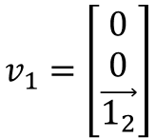
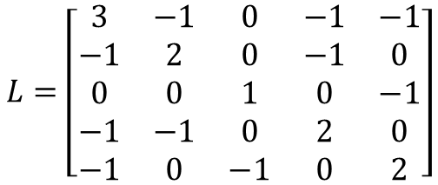
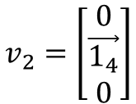
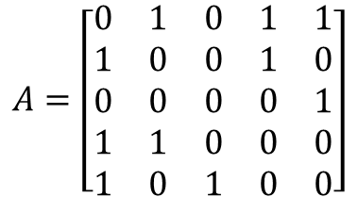
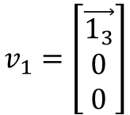
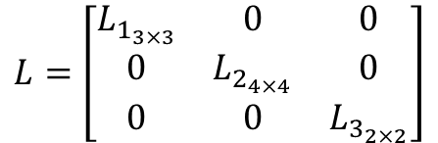
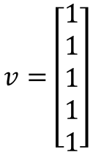
Graph Theory
proximity matrix
1
5
$$A=\left[\begin{matrix}0 & 1 & 0 & 1 & 1 \\ 1 & 0 & 0 & 1 & 0 \\ 0 & 0 & 0 & 0 & 1 \\ 1 & 1 & 0 & 0 & 0 \\ 1 & 0 & 1 & 0 & 0\end{matrix}\right]$$
2
4
3
Node, Branch, Neighbors, Connected Graph
Undirected graph
Symmetric Matrix
Laplacian Matrix
$$v=\left[\begin{matrix}1 \\ 1 \\ 1 \\ 1 \\ 1\end{matrix}\right]$$
$$v_{1}=\left[\begin{matrix}\vec{1_{3}} \\ 0 \\ 0\end{matrix}\right]$$
$$v_{1}=\left[\begin{matrix}0 \\ 0 \\ \vec{1_{2}}\end{matrix}\right]$$
$$L=\left[\begin{matrix}3 & −1 & 0 & −1 & −1 \\ −1 & 2 & 0 & −1 & 0 \\ 0 & 0 & 1 & 0 & −1 \\ −1 & −1 & 0 & 2 & 0 \\ −1 & 0 & −1 & 0 & 2\end{matrix}\right]$$
$$L=\left[\begin{matrix}L_{1_{3×3}} & 0 & 0 \\ 0 & L_{2_{4×4}} & 0 \\ 0 & 0 & L_{3_{2×2}}\end{matrix}\right]$$
$$v_{2}=\left[\begin{matrix}0 \\ \vec{1_{4}} \\ 0\end{matrix}\right]$$
1 zero eigenvalue
Positive semi-definite
3 zero eigenvalues

Slide 7
Non-Holonomic Mechanical system
”Non-holonomic system: “is a system whose state depends on the path taken in order to achieve it”
States cannot change arbitrary and some constraint must be met in order to reach the wanted states
automobile, mobile robot, UAVs and
A Tangible example: Double Park of car

Slide 8
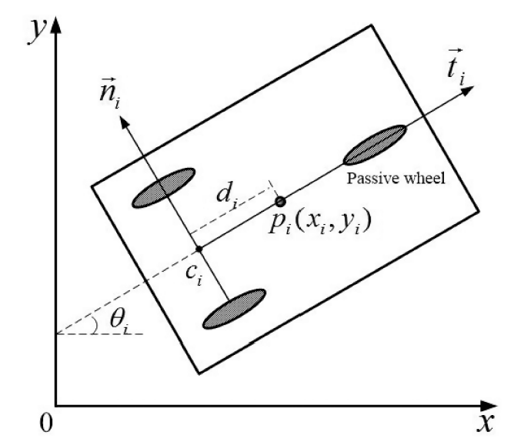



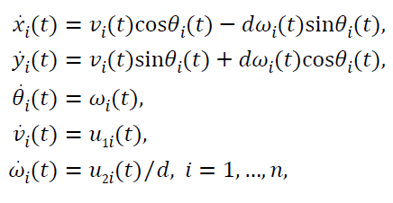

Non-Holonomic Mobile Robot
mobile base satisfies the conditions of pure rolling and non-slipping
Non-holonomic constraint for mobile robot
Second order Non-linear model
Linear/Angular Velocities
Control input proportional to
Driving force & steering torque

Slide 9
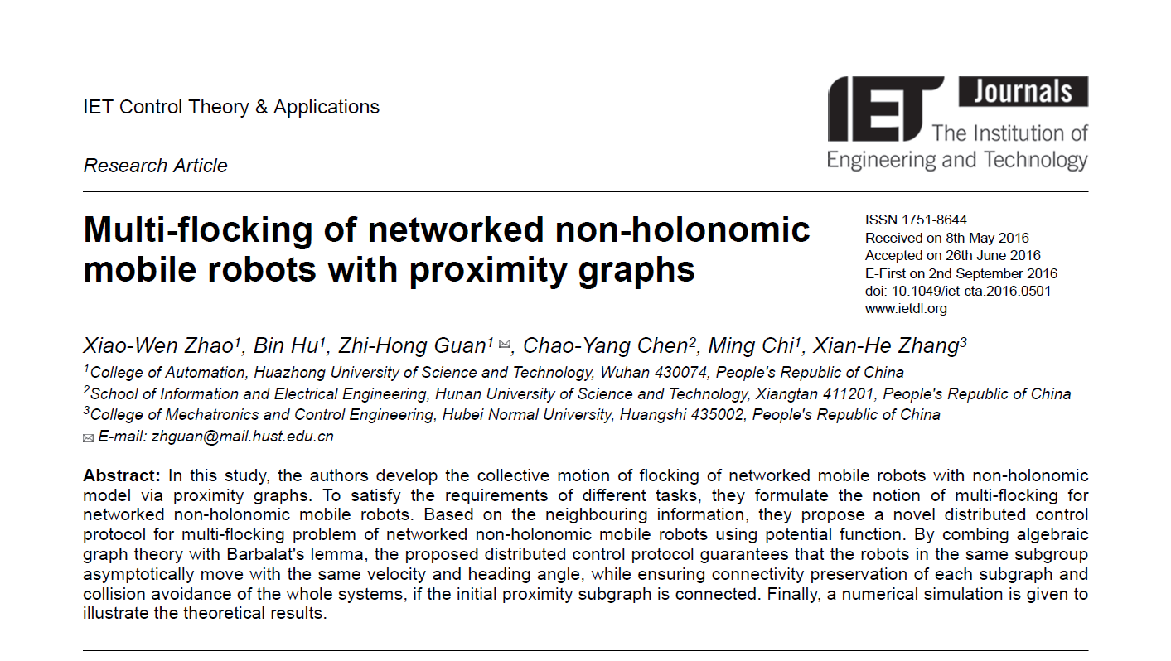
Selected Article for this research
Zhao, Xiao-Wen, et al. ”Multi-flocking of networked non-holonomic mobile robots with proximity graphs.” IET Control Theory and Applications 10.16 (2016): 2093-2099.

Slide 10
Main Contribution of selected paper
develop the collective motion of flocking of networked mobile robots with non-holonomic model via proximity graphs
Multi-flocking system
Based on neighboring information → Distributed Algorithm
By combing algebraic graph theory with Barbalat's lemma suggests that
guarantees that the robots in the same subgroup asymptotically move with the same velocities and heading angle
Ensuring connectivity of each robot group
collision avoidance of the whole systems
Assumption:
Initial proximity subgraph is connected
Linear/Angular Velocity cannot be zero simultaneously

Slide 11



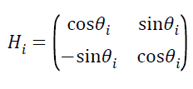






Problem Formulation
group of n non-holonomic mobile robots i=1,…,n
Belongs to m groups
communication range of each robot:
set of neighbors of i robot at t
Proximity Matrix simple dynamic undirected graph to describe model
Node set
Edge set
Laplacian Matrix for proximity matrix (need it for proofs)

Slide 12





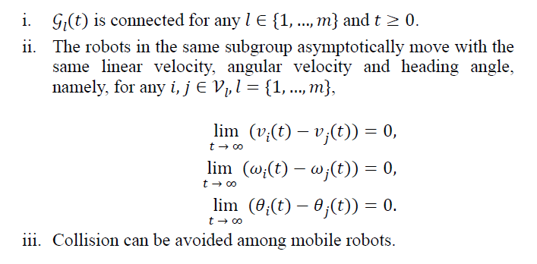
Problem Formulation
We have m groups of robot
Define sub-graph
The multi-flocking of the systems is said to be solved if, for the initial connected sub-graph
we find such that:

Slide 13

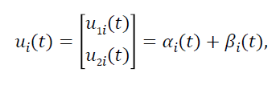

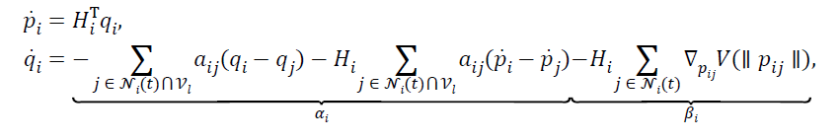
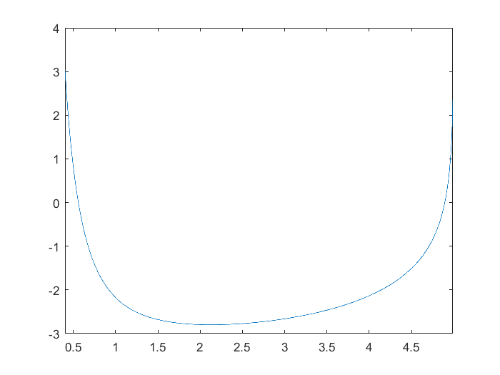
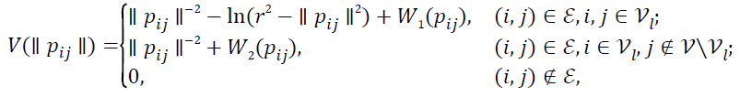
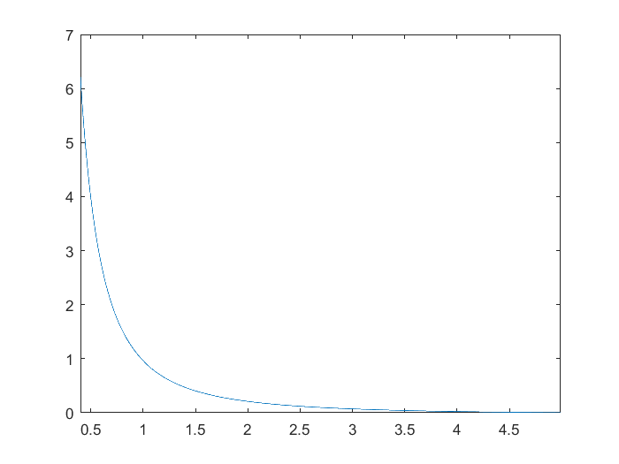
Problem Formulation
Suggested Control input to fulfill requirements:
synchronize the velocities and
heading angles of the robots in the same subgroup
The gradient based term to avoid collisions between the robots and preserve the connectivity of each sub-graph
Artificial potential function
To V be continuous

Slide 14







Main Result
Proof of condition in three steps:
Consider Energy function (Not Lyapunov?)
Constant Graph in interval
Derivative of Energy function:
Is finite
In all
L(t) positive semidefinite
We are not going to lose any link in
Only add new links
Is connected
Stays connected

Slide 15
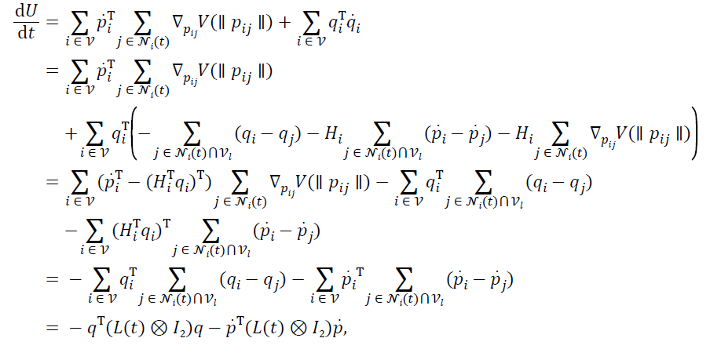
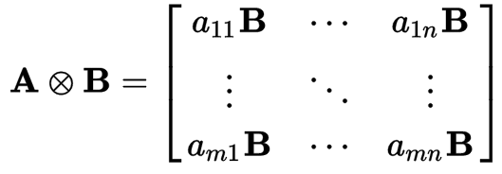
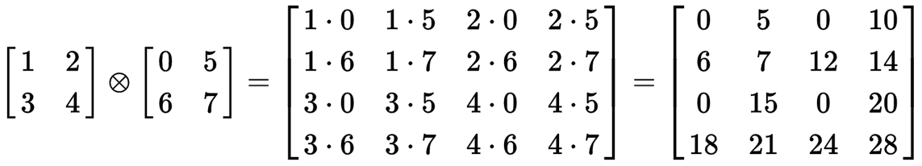
Main Result

Slide 16




Main Result
Second step:
Stays connected
Finite number of switching
Final switching is
Evaluate system in interval
Big Picture
What is next
We know is continuous & differentiable in
We want to show is uniformly continuous
Use Barbalat Lemma to show = 0 as $t→∞$
Use property of Laplacian matrix to show Asymptotically move with same Linear/Angular velocity and heading angle

Slide 17


Main Result
Second step:
Why is continuous & differentiable in
Show it is continuous shortly
No new neighbor is added from same group, Vij of other group continuous in
U has finite value

Slide 18

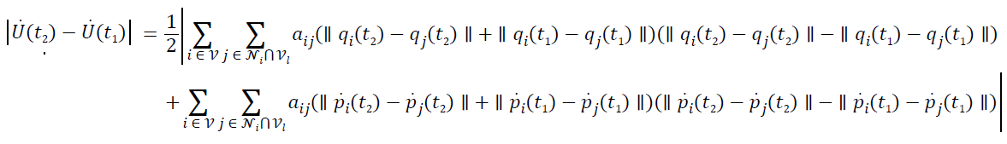


Main Result
Show is continuous:
Consider
We can say:
If is continuous, above expression goes to zero as $t_{1}→t_{2}$
Also we have:
So to show continuity of we need to show continuity of and

Slide 19







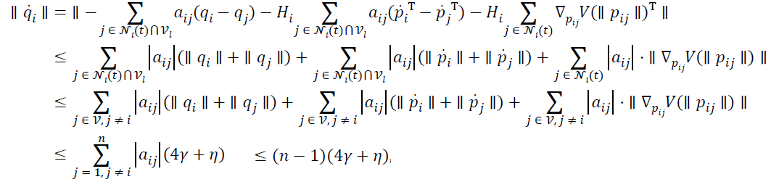
Main Result
To show continuity of and we will show and are bounded.
U has finite value
Also
Also
From definition of V:
Is bounded

Slide 20

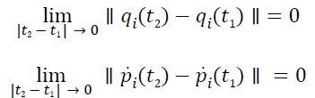

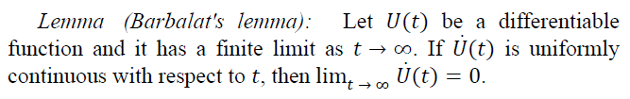


Main Result
To show is bounded
Is bounded
Therefore
[32]

Slide 21

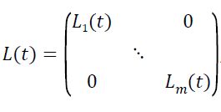
Main Result
Therefore
“Control use only neighbor information , write L(t) as”:
* I think the reason is that group divergence from each other by this method, Consider the case we might have neighbor from other groups

Slide 22



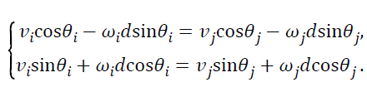

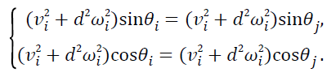


Main Result
Control use only neighbor information , write L(t) as:
From Properties of Laplacian matrix has one eigenvalue equal zero with $\vec{1}$ eigenvector
Linear/Angular Velocity converges to same values in each group
What’s more

Slide 23



Main Result
Third step:
Contradiction:
Contradiction with
no collisions occur between any robots
Done!

Slide 24
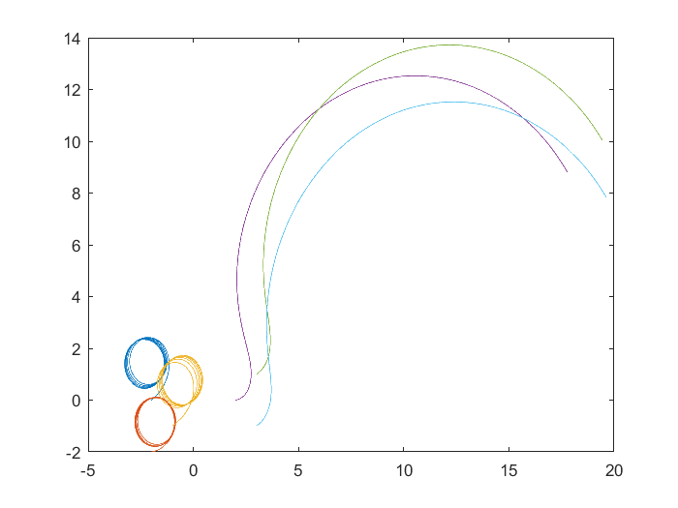
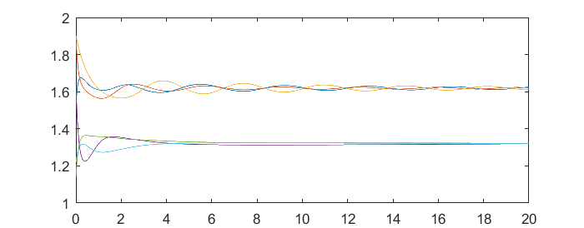
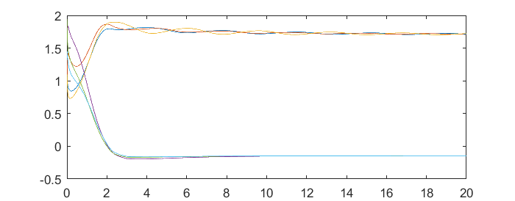
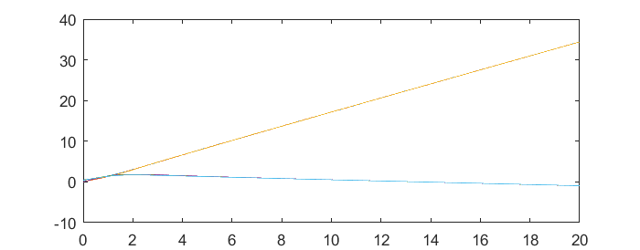

Simulation paper
$$r=5$$
Linear velocity
Angular velocity
Heading angle

Slide 25
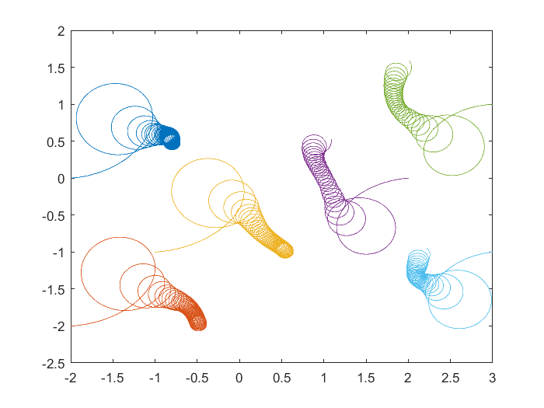
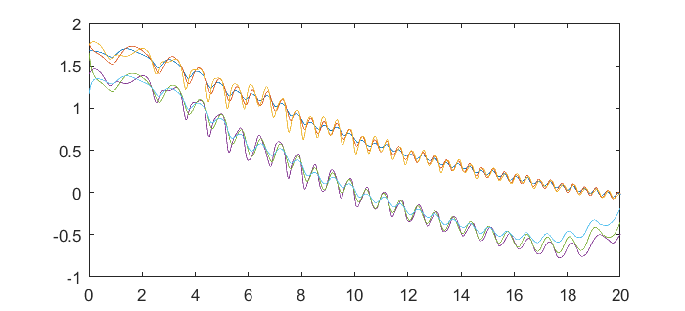
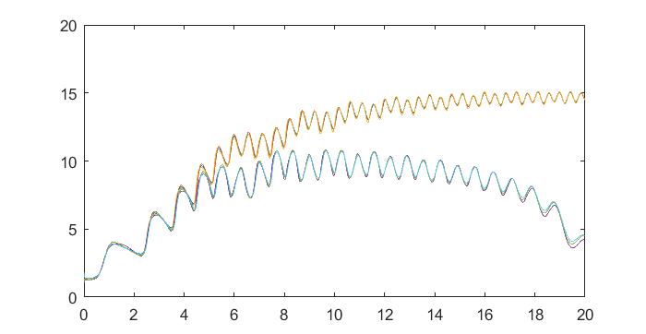
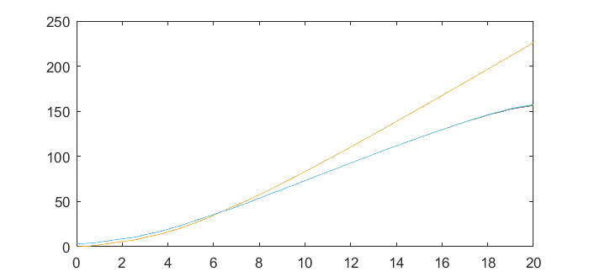
Simulation paper
Heading Angles toward each other
Linear velocity
Angular velocity
Heading angle

Slide 26
My Contribution
Having Obstacle in environment
Trajectory Tracking
My aim is to cover more realistic and practical cases

Slide 27
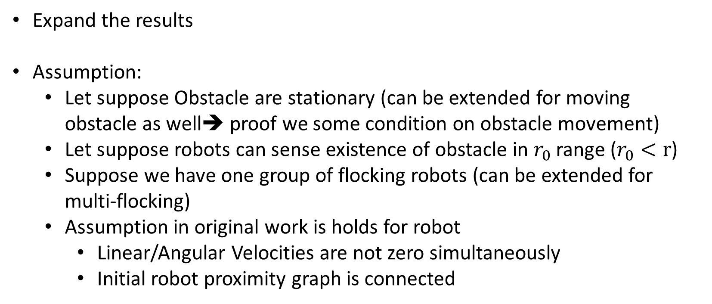
Obstacle in environment
Expand the results
Assumption:
Let suppose Obstacle are stationary (can be extended for moving obstacle as well➔ proof we some condition on obstacle movement)
Let suppose robots can sense existence of obstacle in $r_{0}$ range ($r_{0}<r$)
Suppose we have one group of flocking robots (can be extended for multi-flocking)
Assumption in original work is holds for robot
Linear/Angular Velocities are not zero simultaneously
Initial robot proximity graph is connected

Slide 28
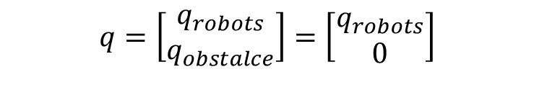
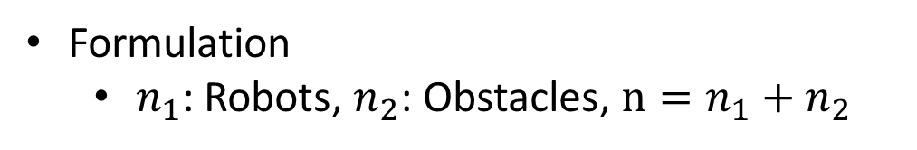

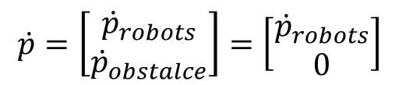
Obstacle in environment
Control objective:
Robots graphs stays connected
Robots groups moves asymptotically with same linear/angular velocities and heading angles in the time intervals that there is no obstacle around
Collision avoided among robots as well as between robots and obstacles
Formulation
$n_{1}$: Robots, $n_{2}$: Obstacles, $n=n_{1}+n_{2}$
$$q=\left[\begin{matrix}q_{robots} \\ q_{obstalce}\end{matrix}\right]=\left[\begin{matrix}q_{robots} \\ 0\end{matrix}\right]$$
$$\dot{p}=\left[\begin{matrix}{\dot{p}}_{robots} \\ {\dot{p}}_{obstalce}\end{matrix}\right]=\left[\begin{matrix}{\dot{p}}_{robots} \\ 0\end{matrix}\right]$$
$$P_{obstacle}=constant$$

Slide 29



Obstacle in environment
Use following control input for robots
communication range of each robot:
$$r∈ℝ^{+}, r_{0}∈ℝ^{+}, r_{0}<r$$
set of neighbors of i robot at t
$$𝒩_{i}\left(t\right)=\{j≠i:\left\|p_{i}\left(t\right)−p_{j}(t)\right\|<r,j∈𝒱\}$$
$$if i,j are both robots$$
$$𝒩_{i}\left(t\right)=\{j≠i:\left\|p_{i}\left(t\right)−p_{j}(t)\right\|<r_{o},j∈𝒱\}$$
$$if i is robot \& j is an obstacle ro vice$$
$$i=1,…,n_{1}$$
To V be continuous, $W_{2}$ is different here

Slide 30


Obstacle in environment
Proof:
1. Robots graphs stays connected
For i,j belongs to obstacle group is a constant
Consider same cost function
Constant Graph in interval
Derivative is negative again, some terms become zero in q and $\dot{p}$
Is finite
In all
L(t) positive semidefinite
We are not going to lose any link in
Only add new links
Is connected
Stays connected
$$for l=1$$

Slide 31
Obstacle in environment
Proof:
2. Robots groups moves asymptotically with same linear/angular velocities and heading angles in the time intervals that there is no obstacle around
Here the case is a little different from without obstacle case,
We assume that we can write L
I think the reason is that groups are divergence from each other
In obstacle case, the group might face an obstacle any time (Generally we have no control on it)
So we can not claims that linear/angular velocities and heading asymptotically same
They behave asymptotically in the time interval that there is no obstacle

Slide 32

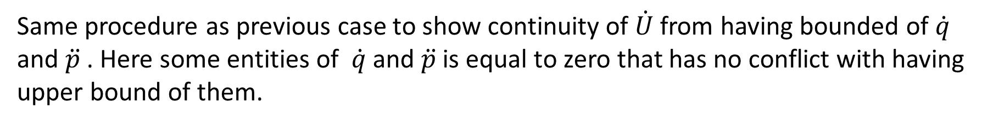
Obstacle in environment
It is not a big deal ➔ Robot graph remains connected when see obstacle
after passing obstacle again converge asymptotically
Investigate behavior of system in interval ${[t}_{f},∞)$
By keeping it in mind that if there is another obstacle facing after $t_{f}$, we can handle it
Same procedure as previous case to show continuity of $\dot{U}$ from having bounded of $\dot{q}$ and $\ddot{p}$ . Here some entities of $\dot{q}$ and $\ddot{p}$ is equal to zero that has no conflict with having upper bound of them.
Laplacian become like follow when we get away from obstacles
By same argument as previous Ang/Lin velocities and heading angle of robot converges (why not for obstacle ☺)

Slide 33
Obstacle in environment
Proof:
3. Collision avoided among robots as well as between robots and obstacles
Exactly same as multi-flocking same
Contradiction with
no collisions occur between any robots
As well as obstacle
Done!

Slide 34
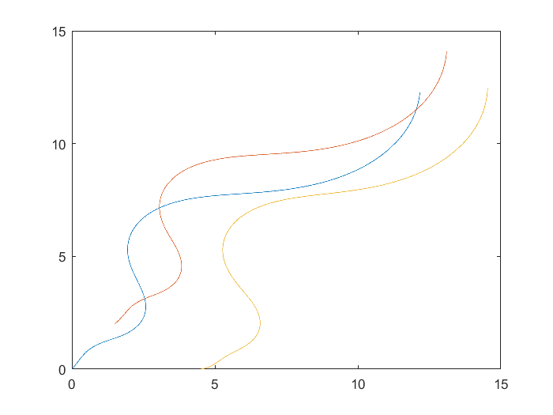
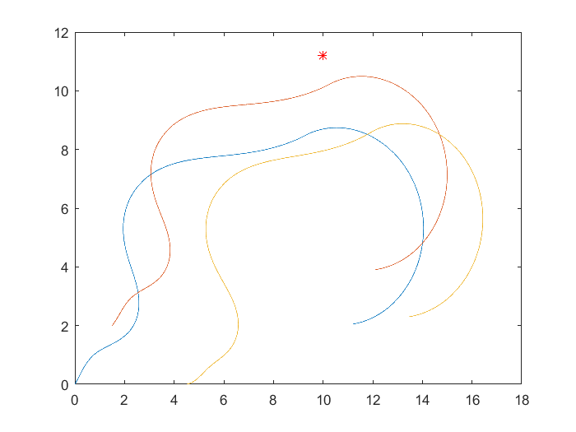
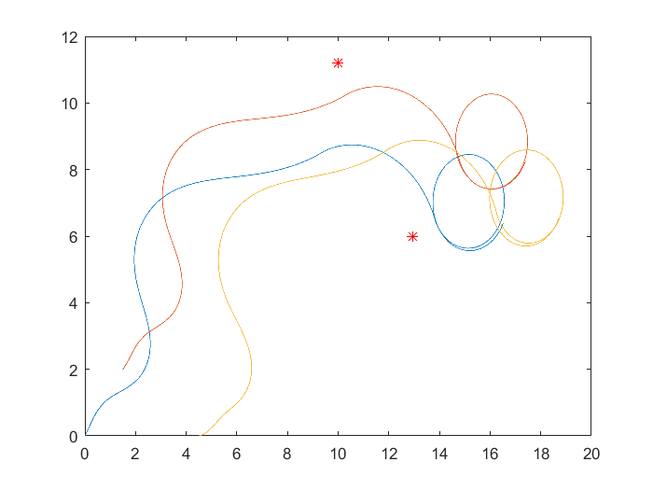
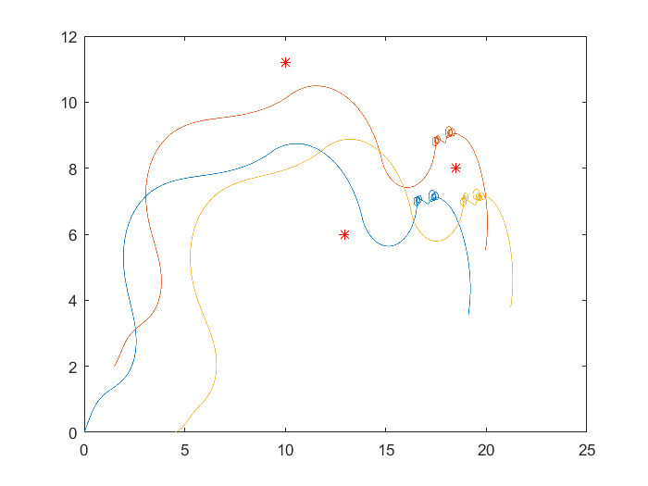
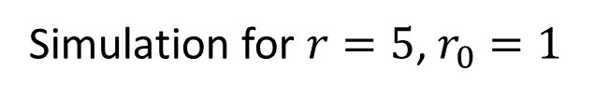
Obstacle in environment
Simulation for $r=5$, $r_{0}=1$
We need trajectory!

Slide 35
Speed trajectory
In most cases we wants our robot groups follow some pattern
Not only randomly converges to some speed
Motivation: choose one robot as leader
Add some small modification term to leader control input
Other robots will follow that robot, all of them converges to the reference speed
Problem Definition: How to show all robots will converges to reference speed acts on leader robot and simultaneously other flocking criteria hold

Slide 36
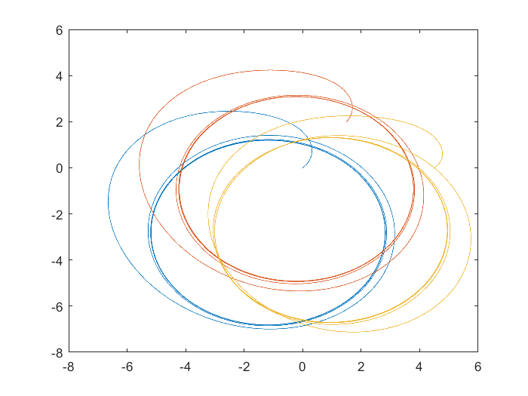
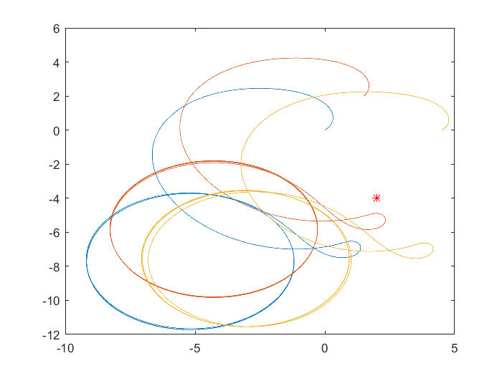
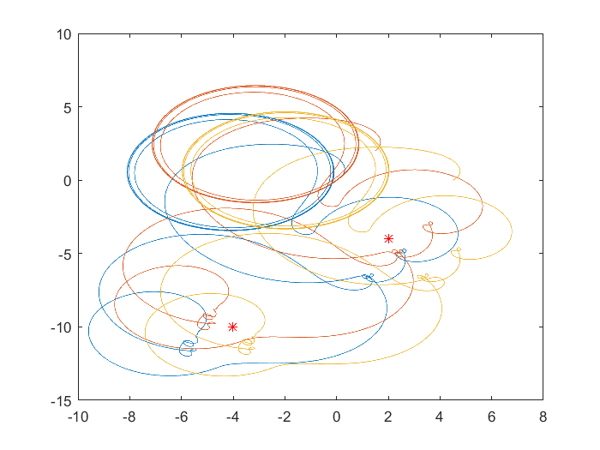
Speed trajectory
Simulation ➔ simple PI controller term added to Robots 1 controller
Circle
Vref=1; Wref=0.25
Add infinity shape trajectory

Slide 37
Speed trajectory
Use Lyapunov to sure convergence to references speed (effect of added term in U and Udot)
Use bounded input with smooth saturation function
Using Backstepping technique

Slide 38
Conclusion & Further study
What we covered in this study:
Studying & Simulation of multi-flocking of networked non-holonomic
mobile robots with proximity graphs (Distributed Control/Graph theory/Energy function)
Extend the problem for Obstacle case (Simulation & Analysis)
Suggest study direction for speed tracking case
Some direction of further study:
Decide with direction is suitable to designing speed trajectory controller
Position Trajectory controller
Extend for multi-flocking case
Evaluate stability for discrete case

Slide 39
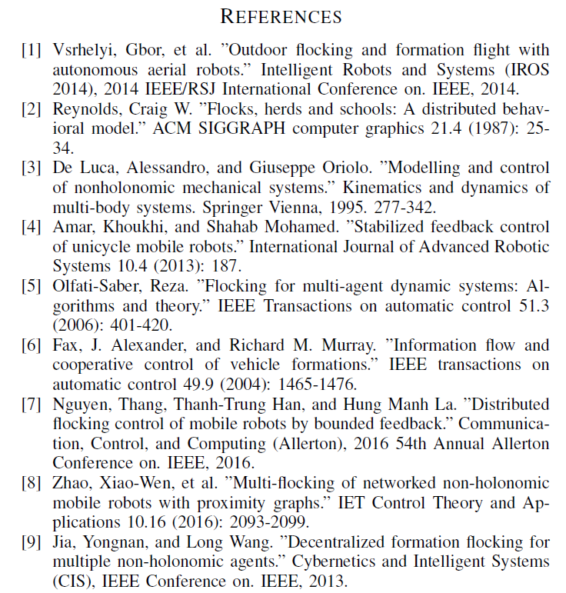
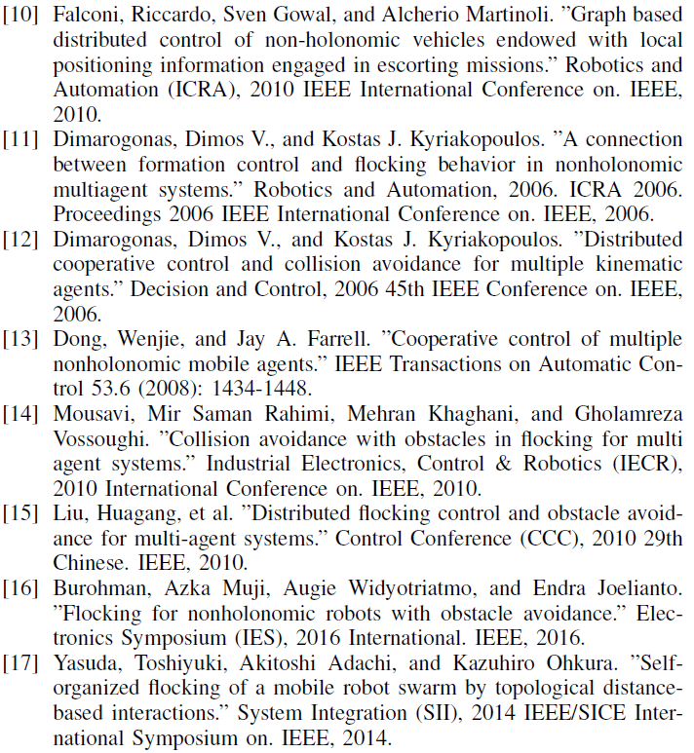

Slide 40
Thanks for your attention

